Slide 1
Task 3 – Mohammed Mahin Ibnay Mamun - 346584 unit 22 - System analysis and design

Slide 2
Contents
Interface Design : page 3 – 10
Flowchart Diagrams : page 11 – 17
Data Flow Diagram : page 18 - 25

Slide 3
Interface Designs
Patient Details - page 4
New Staff Member Details - page 5
Patient Booking – page 6
Patient Arrival System (Receptionist) - page 7
Patient Arrival System (Patient) - page 8
Appointment Notes System - page 9
Patient Re-booking – page 10

Slide 4
Patient Details
Tameside Hospital Logo
Navigation Bar
Sign in / Sign up
Page heading
Patient's date of birth
1)
Patient's full name
2)
Day Month Year
Reset
3)
Patient's gender
Submit button
male
female
4)
Patient's telephone number
Other
Automated feedback box (Depending on how the feedback is received, submissions will either receive positive feedback and confirmation or negative feedback with a detailed explanation as to why they were rejected)
5)
Patient's email address
6)
Patient's NHS number
7)
Patient's address
Time and date at time of registration
7)
KEY
Decision
Alter arrows

Slide 5
New staff member detail
Tameside Hospital Logo
Navigation Bar
Sign in / Sign up
Page heading
1)
Staff member's full name
2)
Staff member's title
1)
Staff member username
3)
Staff member's date of birth
4)
Staff member's gender
Male
Female
Other
2)
Staff member password
Day Month Year
Reset
Submit button
5)
Staff member's telephone number
6)
Staff member's email address
Automated feedback box (Depending on how the feedback is received, submissions will either receive positive feedback and confirmation or negative feedback with a detailed explanation as to why they were rejected)
7)
Staff member's address
Reset
Confirm
KEY
Decision
Alter arrows

Slide 6
Patient Booking
Tameside Hospital Logo
Navigation Bar
Sign in / Sign up
Page heading
Patient's date of birth
1)
Patient's full name
2)
Reset
Day Month Year
3)
Patient's gender
Submit button
Male
Female
4)
Patient's telephone number
Other
Automated feedback box (Depending on how the feedback is received, submissions will either receive positive feedback and confirmation or negative feedback with a detailed explanation as to why they were rejected)
6)
Patient's NHS number
5)
Patient's email address
8)
Time and date for appointed
7)
Patient's address
Day __ Time__:__ ()
​
9)
Patient's Preferred doctor
10)
reason for appointment
Doctors Name : _________
Automated feedback after submission. This will give a reference number
KEY
Decision
Alter arrows
Appointment number

Slide 7
Patient arrival system receptionist
Tameside Hospital Logo
Sign in / Sign up
Navigation Bar
Page heading
Patient's date of birth
1)
Patient's full name
2)
Reset
Day Month Year
3)
Patient's gender
Submit button
male
female
4)
Patient's telephone number
Other
6)
Patient's NHS number
Automated feedback box (Depending on how the feedback is received, submissions will either receive positive feedback and confirmation or negative feedback with a detailed explanation as to why they were rejected)
5)
Patient's email address
8)
Time and date for appointed
7)
Patient's address
Day __ Time__:__ ()
​
9)
Patient's Preferred doctor
10)
Appointment number
Doctors Name : _________
KEY
Decision
Alter arrows

Slide 8
Patient arrival system Patient
Tameside Hospital Logo
Sign in / Sign up
Navigation Bar
Page heading
Patient's date of birth
1)
Patient's full name
2)
Reset
Day Month Year
3)
Patient's gender
Submit button
male
4)
female
Patient's telephone number
Other
6)
Patient's NHS number
Automated feedback box (Depending on how the feedback is received, submissions will either receive positive feedback and confirmation or negative feedback with a detailed explanation as to why they were rejected)
5)
Patient's email address
8)
Time and date for appointed
7)
Patient's address
Day __ Time__:__ ()
​
9)
Patient's Preferred doctor
10)
Appointment number
Doctors Name : _________
KEY
Decision
Alter arrows

Slide 9
appointment notes
Tameside Hospital Logo
Sign in / Sign up
Navigation Bar
Page heading
Patient's date of birth
1)
Patient's full name
2)
Day Month Year
Automated feedback box (Depending on how the feedback is received, submissions will either receive positive feedback and confirmation or negative feedback with a detailed explanation as to why they were rejected)
3)
Patient's gender
male
4)
female
Patient's telephone number
Other
6)
Patient's NHS number
5)
Patient's address
8)
Time and date for appointed
7)
Patient's Preferred doctor
Day __ Time__:__ ()
​
Doctors Name : _________
Reset
10)
Appointment number
9)
Reason for Appointment
Submit button
11)
Medications/Prescriptions
KEY
Decision
Alter arrows

Slide 10
Patient re- Booking
Tameside Hospital Logo
Navigation Bar
Sign in / Sign up
Page heading
Patient's date of birth
1)
Patient's full name
2)
Reset
Day Month Year
3)
Patient's gender
Submit button
male
4)
female
Patient's telephone number
Automated feedback box (Depending on how the feedback is received, submissions will either receive positive feedback and confirmation or negative feedback with a detailed explanation as to why they were rejected)
Other
6)
Patient's NHS number
5)
Patient's email address
8)
Time and date for appointed
7)
Patient's address
Day __ Time__:__ ()
​
9)
Patient's Preferred doctor
10)
reason for appointment
Doctors Name : _________
Automated feedback after submission. This will give a reference number
KEY
Decision
Alter arrows
Appointment number

Slide 11
System Flowchart
Patient Details – page 12
New Staff Member Details - page13
Patient Booking - page 14
Patient Arrival System (Receptionist) - page 15
Patient Arrival System (Patient) - page 16
Appointment Notes System - page 17

Slide 12
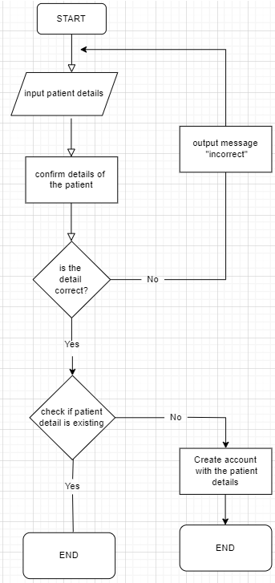
Patient Details

Slide 13
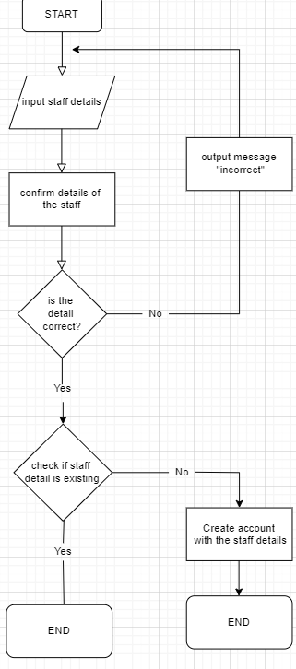
New staff details

Slide 14
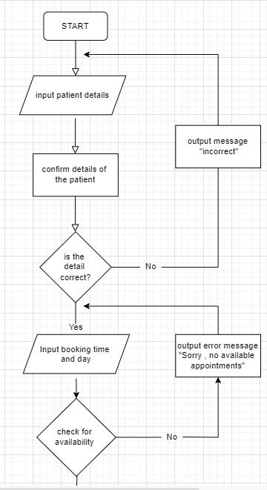
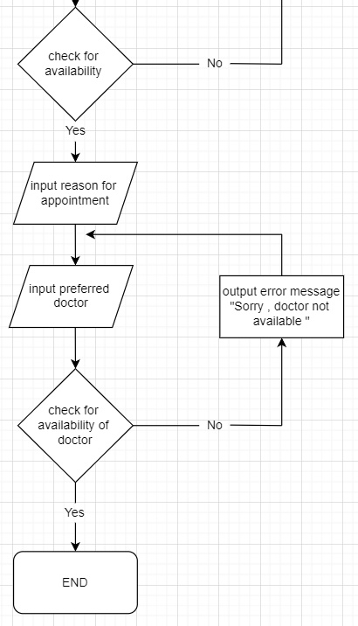
Patient booking

Slide 15
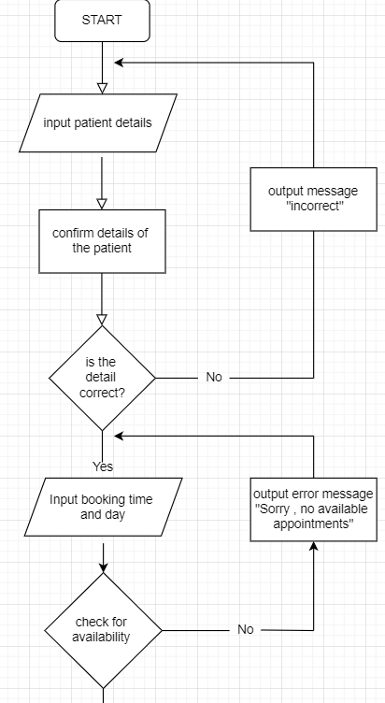
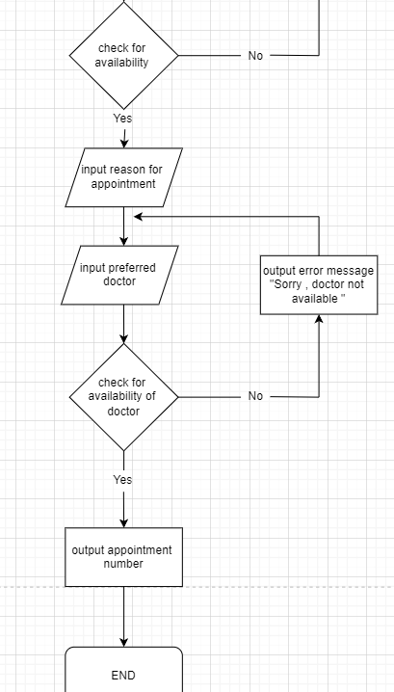
Patient arrival
System (reception)

Slide 16
Patient arrival
System (Patient)

Slide 17
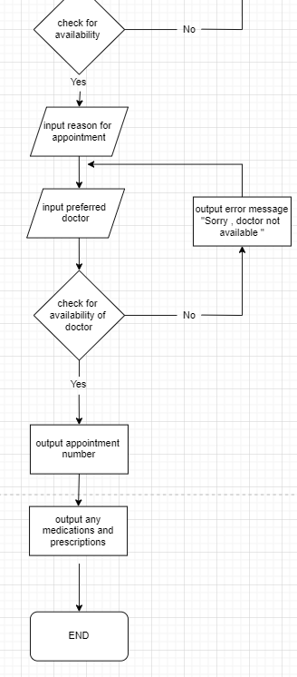
Appointment notes

Slide 18
Data Flow Diagram
Patient Details – page 19
New Staff Member Details – page 20
Patient Booking – page 21
Patient Arrival System (Receptionist) - page 22
Patient Arrival System (Patient) - page 23
Appointment Notes System – page 24
Patient Re-booking – page 25

Slide 19
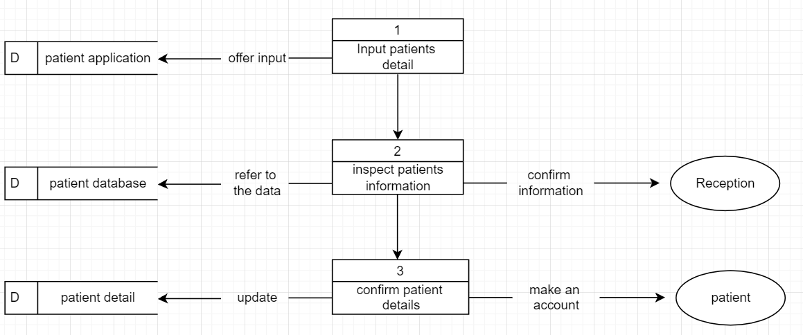
Patient Details

Slide 20
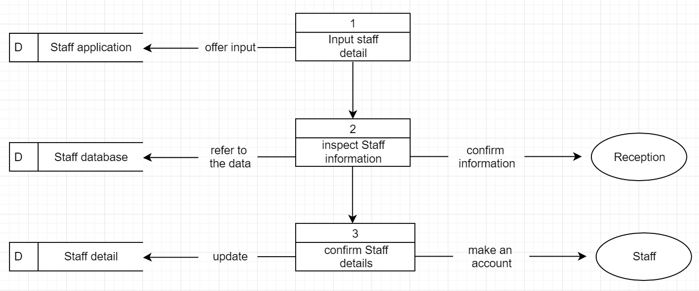
New staff member details

Slide 21
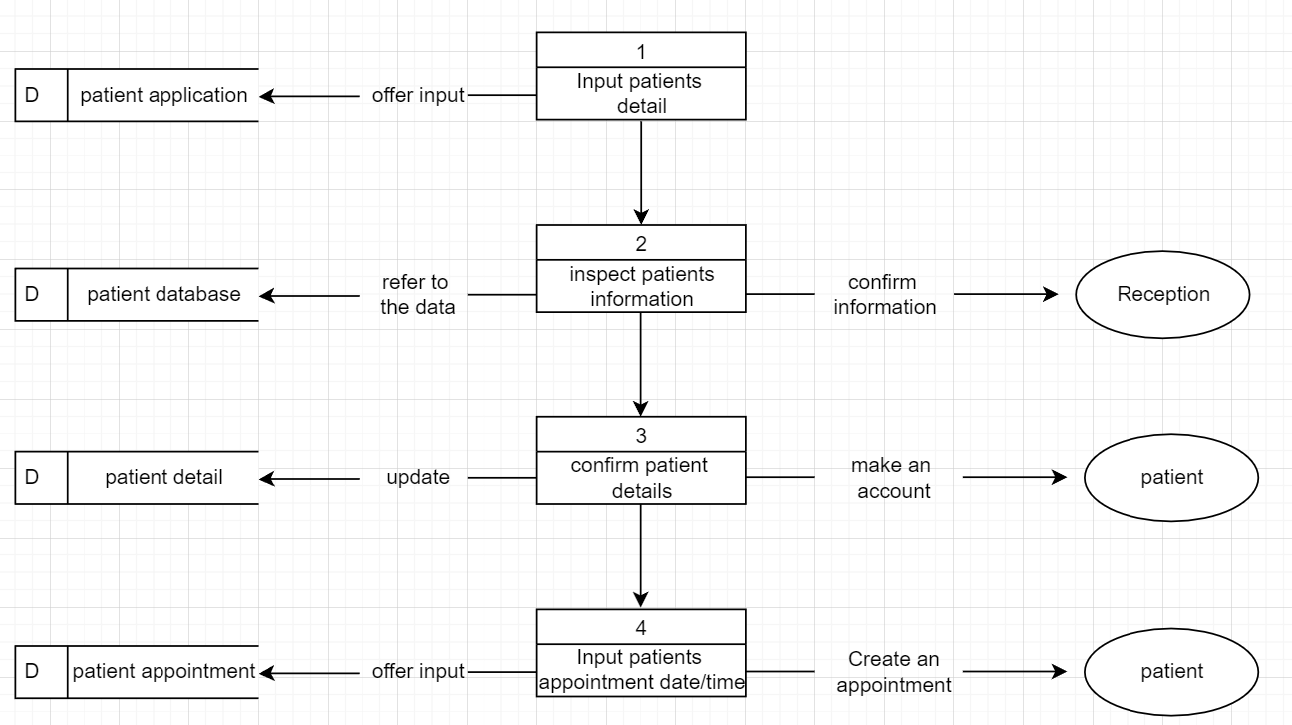
Patient Booking

Slide 22
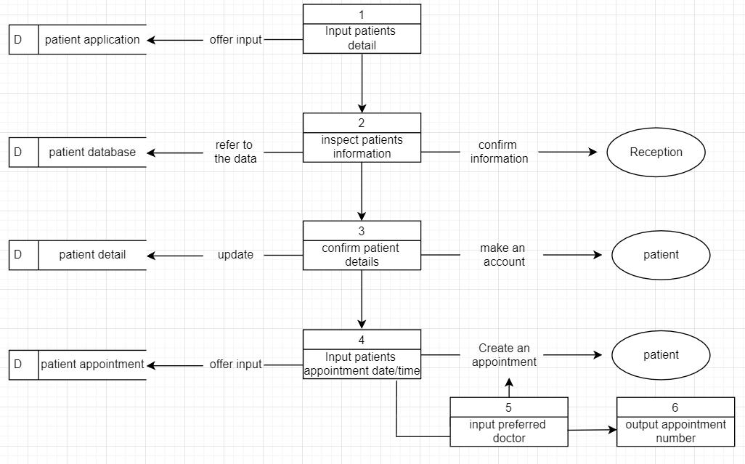
Patient arrival system (Receptionist)

Slide 23
Patient arrival system (Patient)

Slide 24
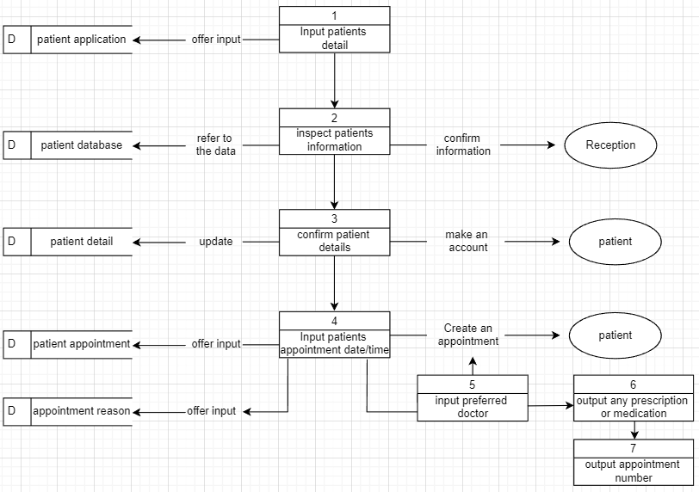
Appointment notes system

Slide 25
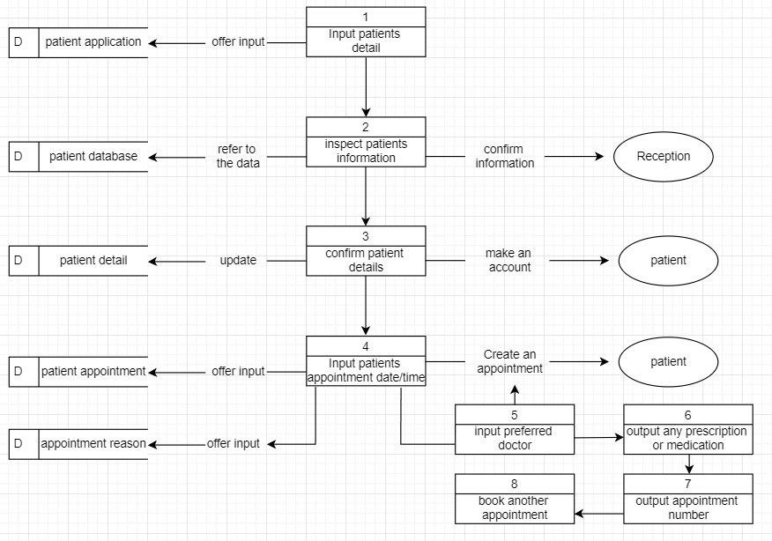
Patient Re-booking

